Slide 1
Use of Force Data Collection
Presented by MSHP CJIS
Technical Training and Audit Section –
UCR & CJ Audit Program

Slide 2
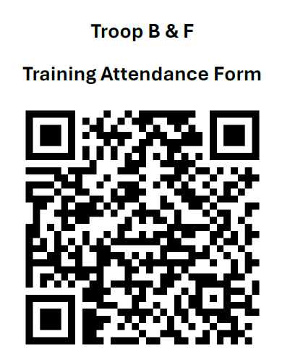

Slide 3
CJIS Staff
Assistant Director:
Elisha Carlock
573-526-6153 ext. 2604
Elisha.Carlock@mshp.dps.mo.gov
JAY STALLONS
TROOP A & H Senior Program Specialist
573-526-6153 ext. 2816
Jay.Stallons@mshp.dps.mo.gov
VACANT
TROOP C METRO Senior Program Specialist
573-526-6153
UCR@mshp.dps.mo.gov
CHELSEY KINCAID
TROOP C RURAL Senior Program Specialist
573-526-6153 ext. 6805
Chelsey.Kincaid@mshp.dps.mo.gov
KEVIN NEELEY
Troop B & F Senior Program Specialist
573-526-6153 ext. 2632
Kevin.Neeley@mshp.dps.mo.gov
VACANT
TROOP D Senior Program Specialist
417-895-6868
UCR@mshp.dps.mo.gov
SCOTT CLINE
TROOP E, G, & I Senior Program Specialist
417-469-3726 ext. 3761
Scott.Cline@mshp.dps.mo.gov

Slide 4
What are the benefits?
Allows the agency data to guide the narrative
Allows for a clearer picture of Use of Force across the nation
Allows for uniform data to be collected on use of force
Required by RSMo 590.1265 - “Police Use of Force Transparency Act of 2021”
Notes:
We’ve all heard “this always happens” by being transparent with our data allows us to dispel these misconceptions. In addition, collecting uniform data allows us to compare apples to apples instead of apples to oranges since most departments or states did not collect similar data.
Quote from Minnesota Justice Information Services “Our Superintendent’s take on the matter is that collecting the data allows us to drive the narrative rather than others with anecdotal information. In addition, he believes that it is better to be transparent so we can be proactive in identifying any potential issues or problems and take steps to make improvements. It also helps in showing the whole picture.”

Slide 5
HOW WAS IT DEVELOPED?
Approved by the CJIS Advisory Policy Board (APB) made up of our peers
Endorsed by International Association of Chiefs of Police (IACP) and the National Sheriff’s Association (NSA)
***Per the FBI, this data will not “allow for the final disposition or adjudication of a use of force incident”

Slide 6
Use of Force - Requirements
Police Use of Force Transparency Act of 2021
  590.1265. Citation of law — definitions — use-of-force incidents reporting, standards and procedures — publication of report data — analysis report. — 1. The provisions of this section shall be known and may be cited as the "Police Use of Force Transparency Act of 2021". Starting on March 1, 2022, and at least annually thereafter, each law enforcement agency shall collect and report local data on use-of-force incidents involving peace officers to the National Use of Force Data Collection
Requires reporting of qualifying Use of Force Incidents by all Law Enforcement agencies in Missouri
Notes:
DPS Policies and Standards set guidelines

Slide 7
Use of Force - Definitions
Per RSMo 590.1265
  "Law enforcement agency", defined in section RSMo 590.1040 as:
    Any public agency that employs law enforcement personnel Includes any Local, County and State Officers including Marshalls and Special Agents
  "Peace officer", defined in section 590.010 as:
    A law enforcement officer of the state or any political subdivision of the state with the power of arrest for violation of criminal code or declared or deemed a peace officer by state statute
Notes:
Federal not included

Slide 8
What Qualifies as an Incident?
Police Use of Force Transparency Act of 2021 - Reporting Requirements
  USE OF FORCE INCIDENT is defined as:
    A fatality occurs that is connected to a use of force by a peace officer:
    Serious bodily injury occurs that is connected to a use of force by a peace officer;
    In the absence of death or serious physical injury, a peace officer discharges a firearm at, or in the direction of a person(s)
Notes:
FBI is only looking at use of force with a firearm

Slide 9
Use of Force Data
Who owns the data?
  The agency owns the data
    MSHP merely serves as a conduit
  The agency will be able to update data
    An agency unable to provide some information, such as officer characteristics may submit incomplete reports with some data as “pending” or “unknown.”

Slide 10
How will this data be used/reported?
DPS annual report
FBI CDE
Coming soon: Tops theme on showmecrime.mo.gov

Slide 11
Registration process

Slide 12
How to Get Access
Who will submit for your agency?
Agency UoF Point of Contact (POC)
    Agency will choose someone at the agency to submit UoF
    Can be the MIBRS POC or someone different
    This person will need to register for a UoF access
Utilize UCR User Access Request Form

Slide 13
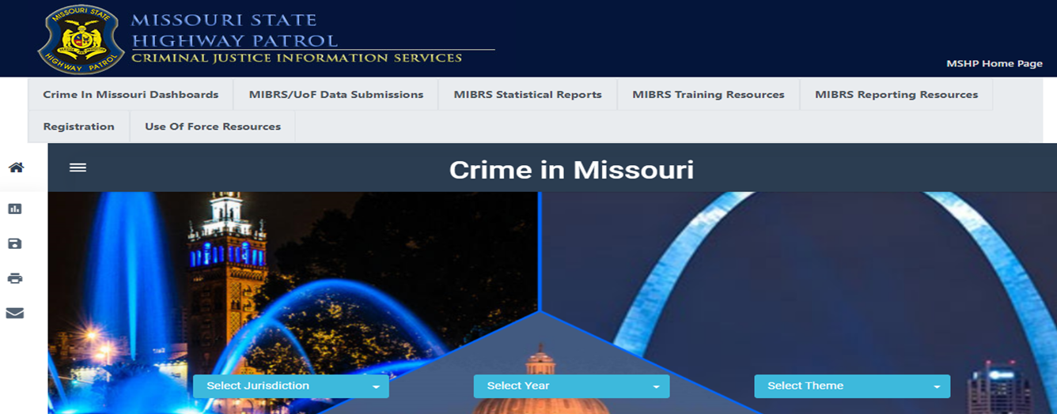
Use of Force - Registration
Registration can be accessed through the MSHP’s Show Me Crime web page
  MIBRS dashboard page

Slide 14
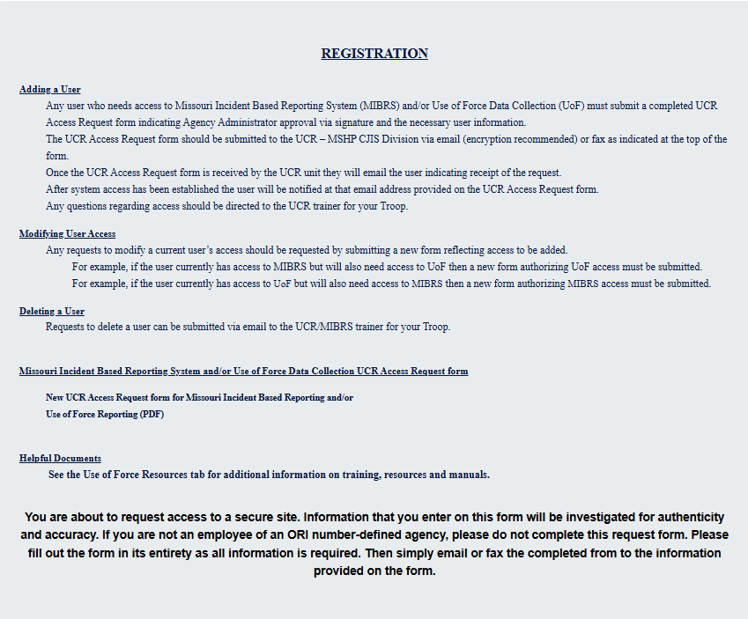

Slide 15
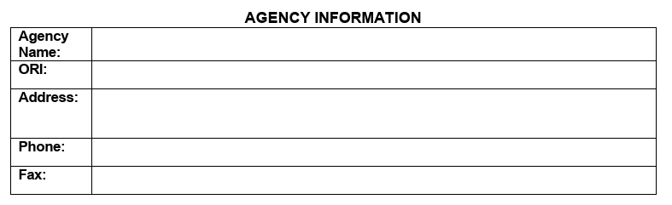
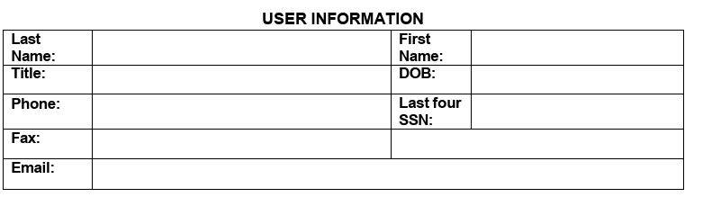
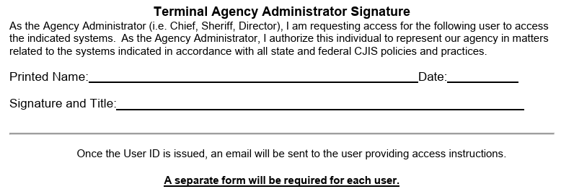
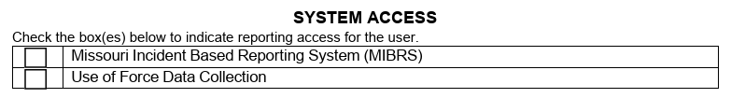
The first section is for
The agency information
The second section is the user information
The last section is for the agency head to sign approving access.
Be sure to check which access is needed, this can be both
If any part of the form is filled out incorrectly, it will delay the process.
i.e. current TAA signature, no box checked

Slide 16

How to remove a mibrs/uof user
Email your trainer/auditor the name of the user that needs to be removed
* This should be done for users who no longer need access due to a change in job duties or are no longer with your agency

Slide 17
When did Submissions begin?
  Started on March 1, 2022
  MSHP has an entry portal available on Show Me Crime webpage (www.showmecrime.mo.gov) which will be demonstrated later
  Failure to comply
    Non-compliance will be handled by DPS in accordance with statutory requirements

Slide 18
SUBMISSION REQUIREMENTS
  Completed by the 10th of the following month
      So that data can be transmitted to the FBI on the 15th
  Even if nothing to report, a zero report must be submitted for each month
  The Use of Force report does not take the place of any federal or state death in custody reports
      Those still need to be submitted separately

Slide 19
Let’s Break Down the Details
What do I need to know to make a Use of Force entry?

Slide 20
Do you have a qualifying incident?
What is considered a User of Force Incident:
  A fatality occurs that is connected to a Use of Force by a peace officer
  Serious bodily injury occurs that is connected to a Use of Force by a peace officer
  In the absence of death or serious physical injury, a peace officer discharges a firearm at, or in the direction of, a person(s)

Slide 21
USE OF FORCE - DEFINITIONS
What is considered “Serious Bodily Injury”?
  RSMo 590.1265 refers to RSMo 556.061 to define “SERIOUS BODILY INJURY” as:
    “physical injury that creates a substantial risk of death or that causes serious disfigurement or protracted loss or impairment of the function of any part of the body;”
  The FBI uses Title 18 United States Code (U.S.C.) section 2246 (4) to define it as:
    bodily injury that involves a substantial risk of death, unconsciousness, extreme physical pain, protracted and obvious disfigurement, or protracted loss or impairment of the function of a bodily member, organ, or mental faculty;
Notes:
Lesson learned: Focus on state statute. The Title 18 definition is more broad.

Slide 22
Use of Force - Definitions
Serious bodily injury would include:
    all gunshot wounds (regardless of whether they are penetrating or grazing)
    apparent broken bones
    possible internal injury, severe laceration, stitches, sutures
    chipped teeth, loss of teeth
    canine bites requiring medical attention
    unconsciousness due to an applied carotid artery hold
    injuries severe enough to require medical intervention and/or hospitalization
The term "medical intervention" does not include routine evaluation of the subject to determine fitness for arrest or detention by an emergency medical technician or medical staff at a medical facility
Notes:
For example: serious bodily injury could result from use of asp or baton

Slide 23
Use of Force - Definitions
Firearm is defined by Title 18 U.S.C. 921 (A)(3):
  any weapon (including a starter gun) which will or is designed to or may readily be converted to expel a projectile by the action of an explosive;
  the frame or receiver of any such weapon;
  any firearm muffler or firearm silencer; or
  any destructive device
Firearms discharged at or in the direction of a person(s) with less lethal munitions, such as beanbags, pepper balls, and rubber bullets are excluded
In addition, electronic control weapons are not to be considered firearms. (Ex: Tasers/Stun Gun etc.)

Slide 24
Now that I know I have an incident what do I do?

Slide 25
Use of Force - Submissions
Data Submission - Two options
    RMS generated FBI compliant UoF file via Crime Insight UoF upload page
    Manual data entry via Crime Insight web entry
Either one is acceptable
Notes:
No CHARGE

Slide 26
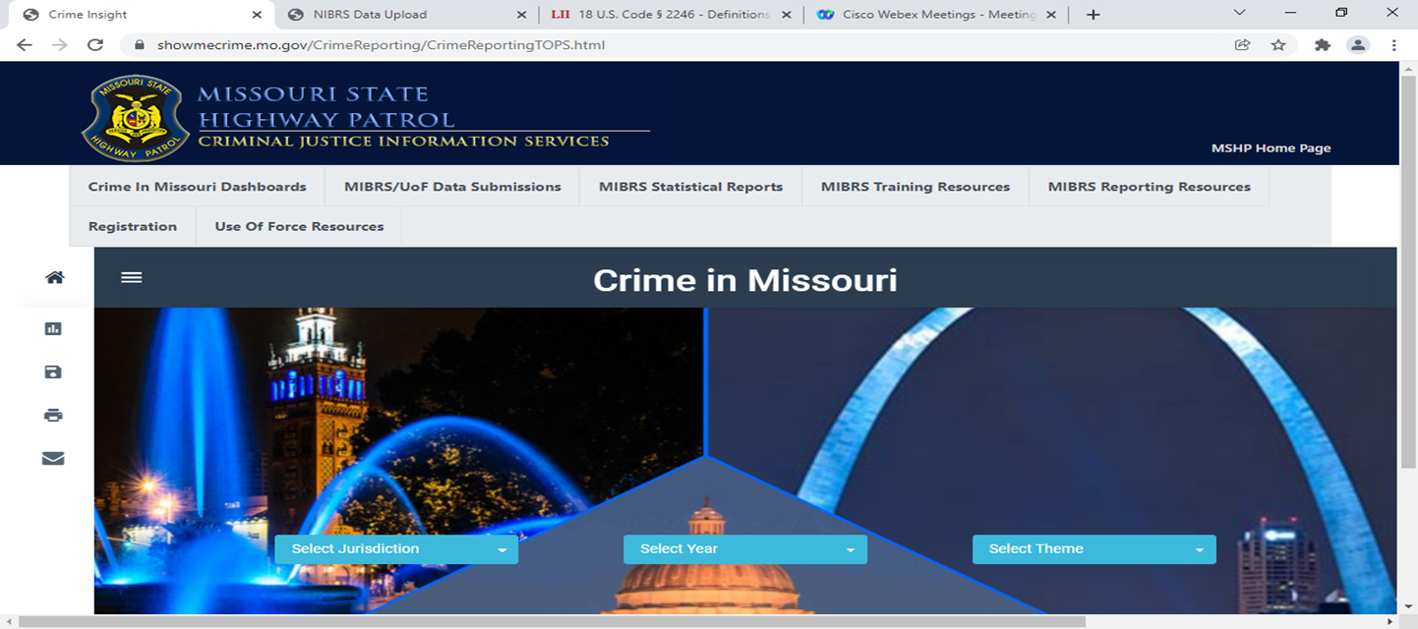
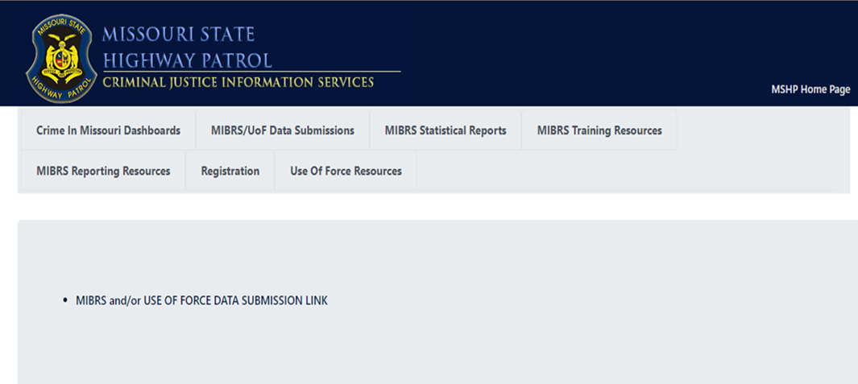
Use of Force
Accessing UoF Submission Page
Click Here
Then Here

Slide 27
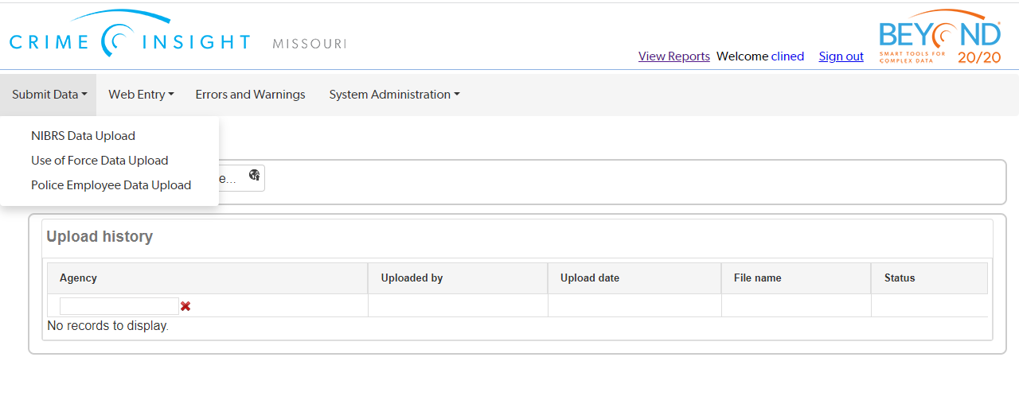
Use of Force – Uploading Data

Slide 28
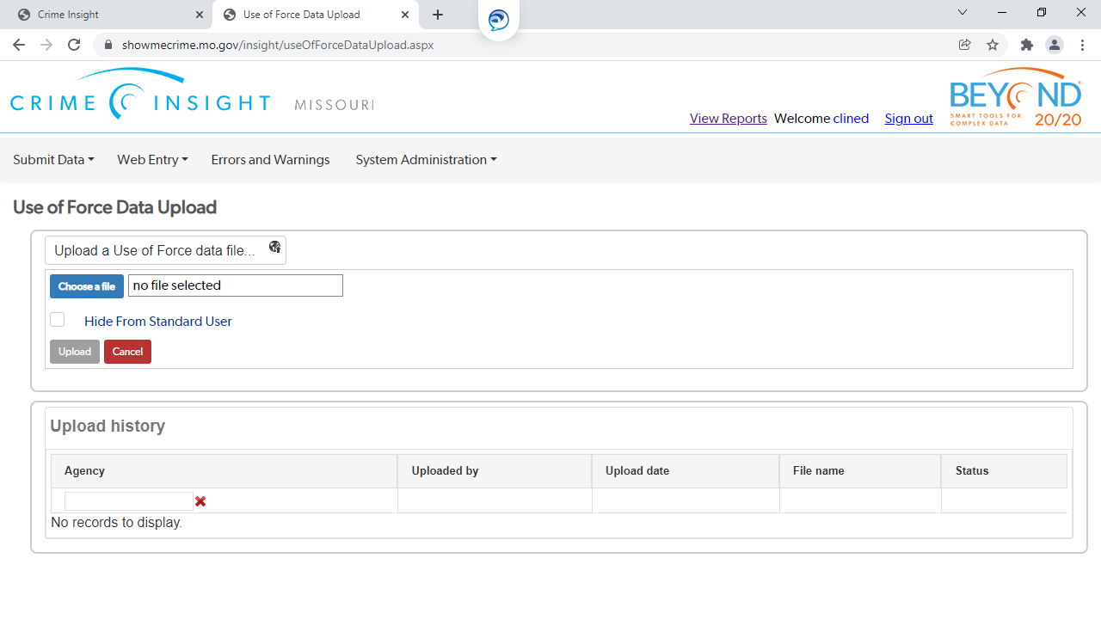
Use of Force – Uploading Data

Slide 29
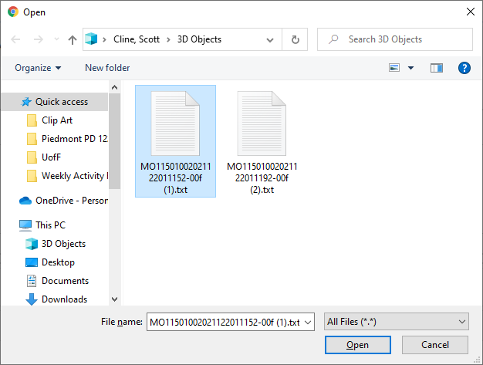
Use of Force – Uploading Data
Submitting from RMS generated file
  Find the file and then click “OPEN”

Slide 30
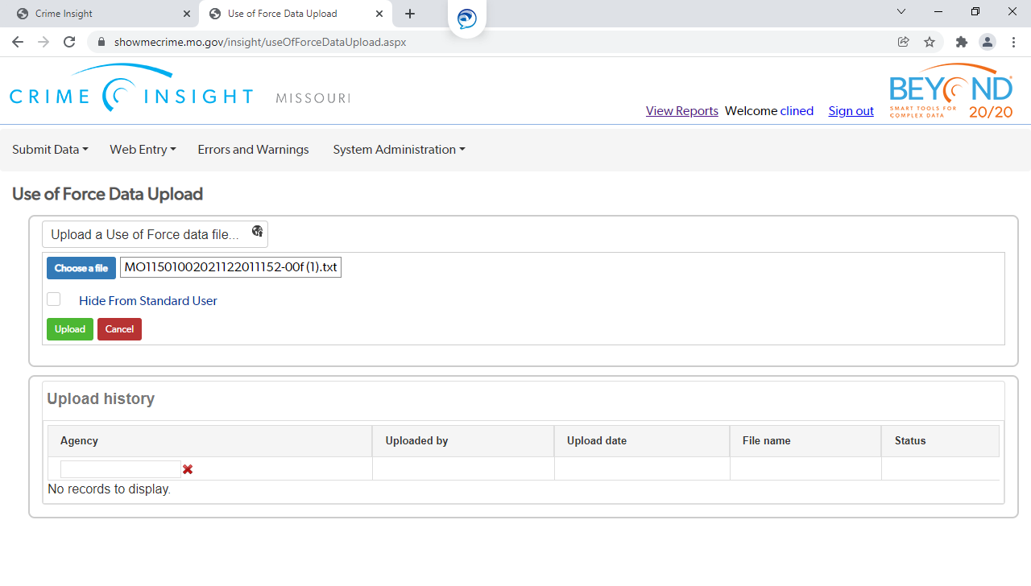
Use of Force – Uploading Data
Submitting from RMS generated file
  Once file name appears in file box, select “UPLOAD”

Slide 31
Use of Force – Uploading Data
Submitting from RMS generated file
File will upload and be validated for errors or warnings
If errors, correct and resubmit the incident(s)
If warnings, review the warned data to ensure that it is accurate
  If not accurate, correct and resubmit
  If accurate, notify your MIBRS Trainer to remove the warning

Slide 32
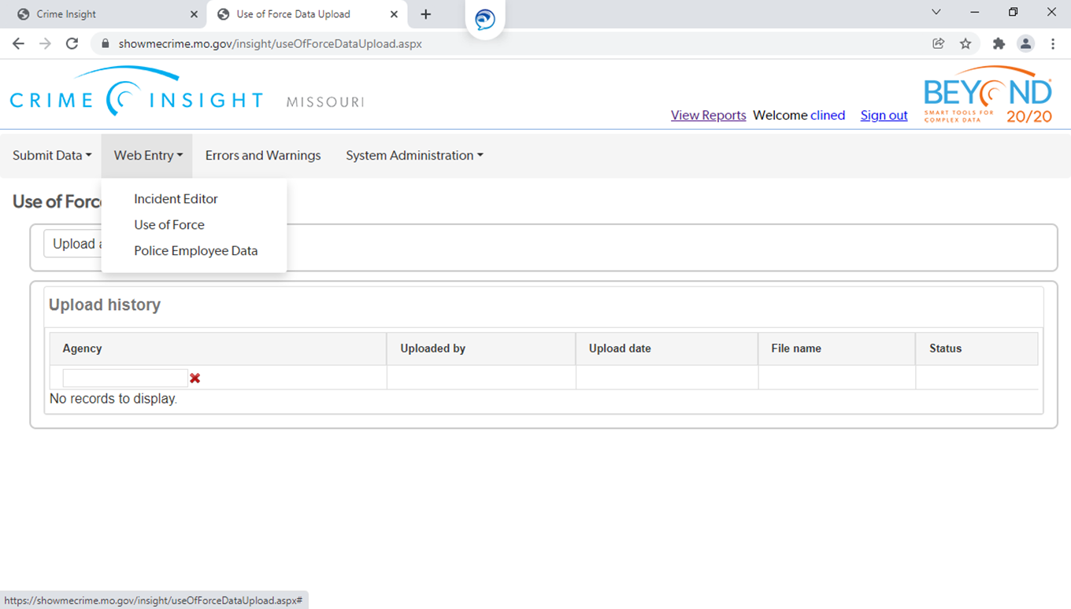
Use of Force - Entry
Submitting through the direct entry portal
Access the entry portal following the same log in steps

Slide 33
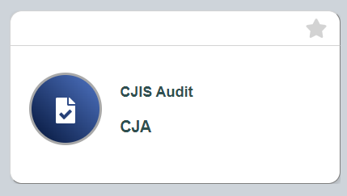
CJIS AUDIT TOOL (CAT)
Effective July 1, 2022
  Electronic questionnaire sent for POC to complete before audit date
Effective January 1, 2026
  Use of Force Audits started going out to agencies

Slide 34
Use of force
Submission demo
  Will cover all information (data elements) required
  For the demo, please refer to:
    Use of Force outline handbook
      Additional technical resources are available on the Use of Force Resource tab on the Show Me Crime webpage

Slide 35
Use of Force - Demo
Any questions before we begin?
You can always reach out to your CJIS Senior Program Specialist, contact info in handout

